Slide 1


TPEX
Finding Infra & Licence
Date : 16th Nov 2022

Slide 2
Agenda
1
1
CI / CD Pipeline
Open Shift
Pipeline
CI /CD Tech Stack
Microservice & DB
Microservice Tech Stack
Summary
2
3
4
5
6
7

Slide 3
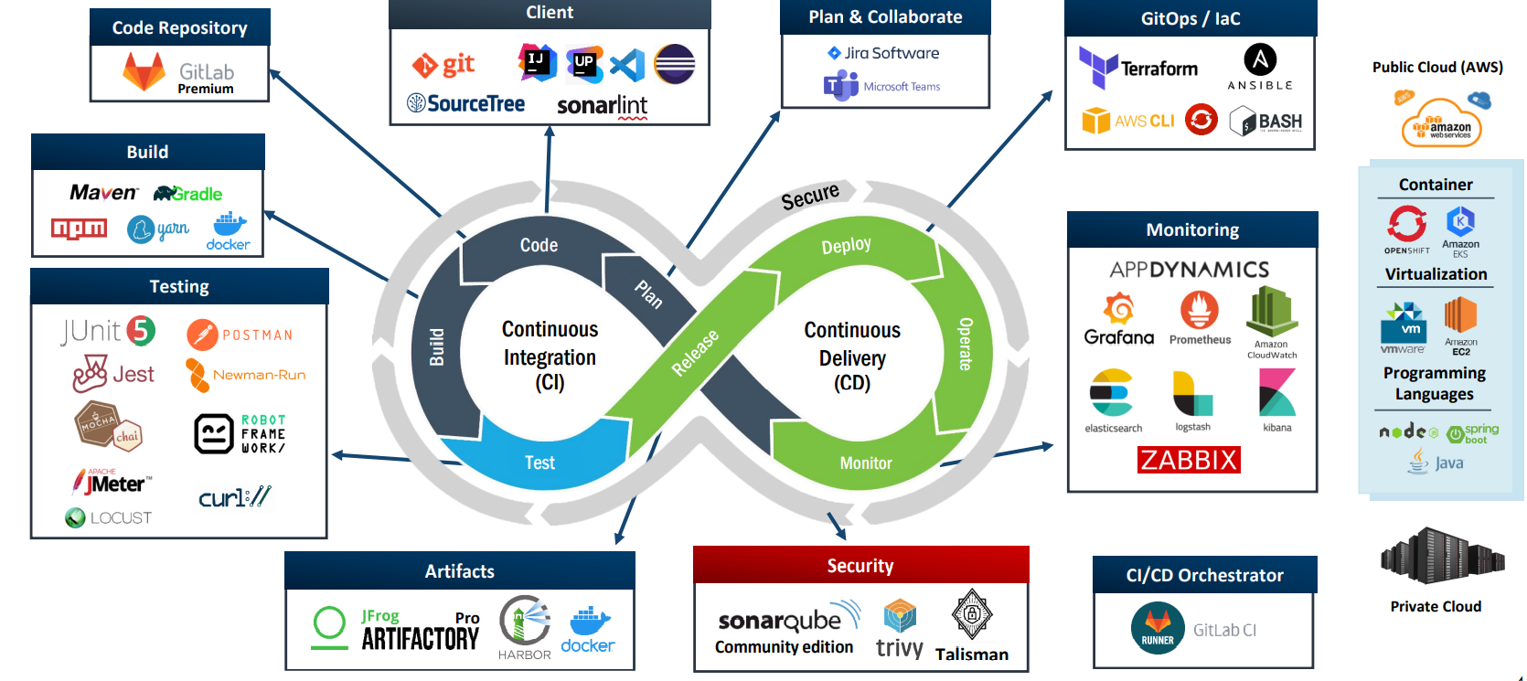
Moderna 102 Approved CI / CD tools

Slide 4
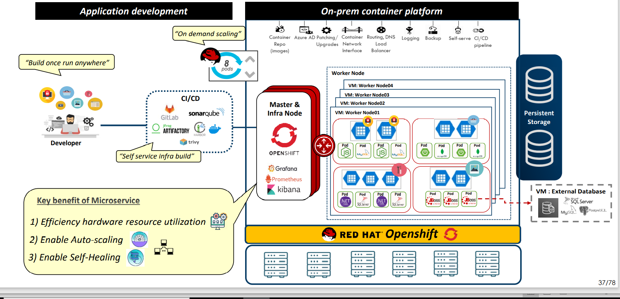
Open shift & CI /CD

Slide 5
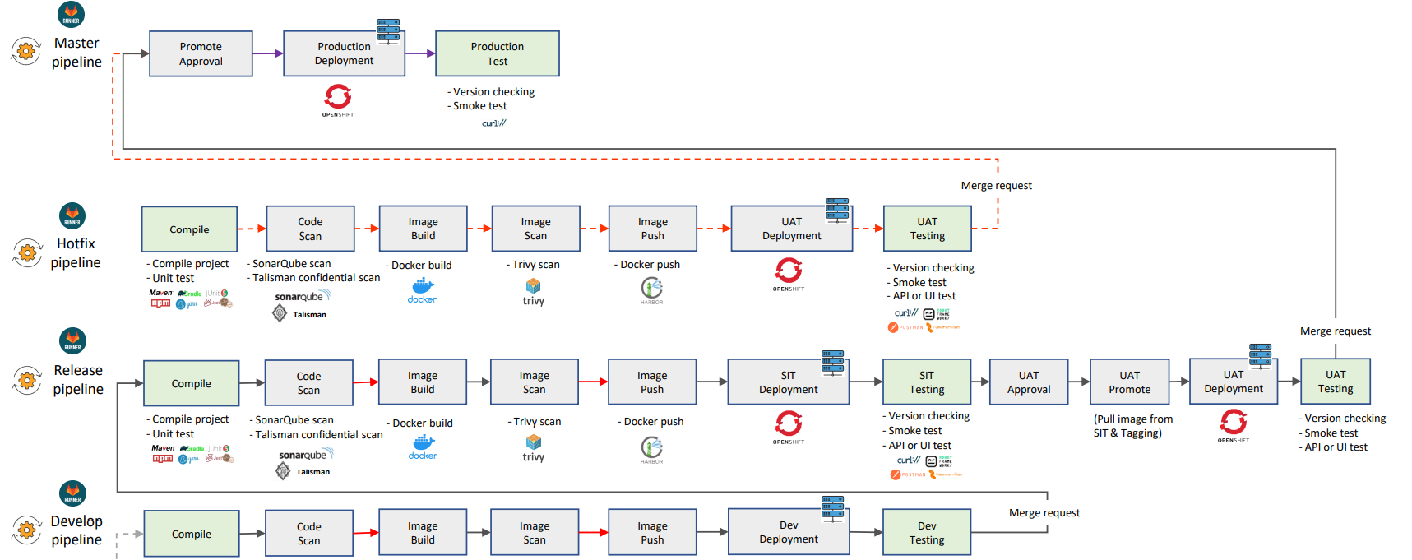
Pipeline, Branch & Merging

Slide 6
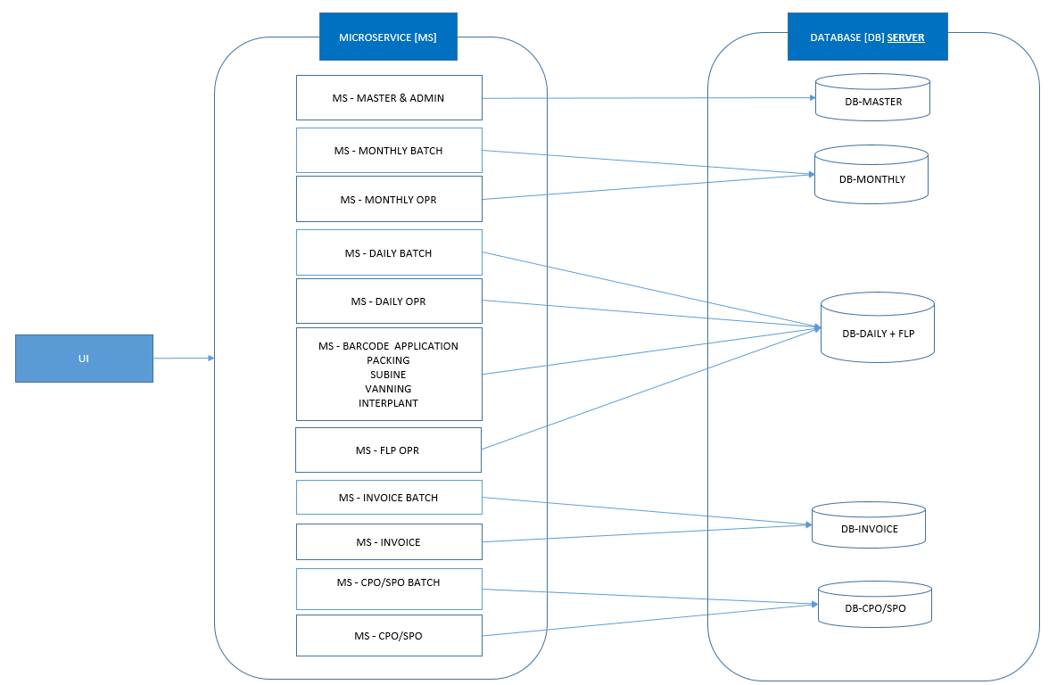
Microservice & DB Mappig

Slide 7
Technology Stack - Micro services
Technology Stack for Development |  | PIC | Target Date
Client Side | HTML5, CSS / Bootstrap, Java Script, React/ React native | App
Core Framework | Spring Boot /Framework, Oauth 2 with Restful Web Services | App
Web server | Tomcat | App
Messaging | Kafka | App
Caching | Redis | App
Batch Framework | Spring Batch | App
Database | MySQL | Infra | When should we expected this
Reporting | Jasper | App
Browser Support | Chrome, MS Edge | App
Automation Testing | Unit Test – JUNIT / BDD API / Robot UI - Part of CI/CD, Acceptance Testing–Part of CI/CD Performance / Load – JMeter | App
CI / CD | Plan/Adapt: Microsoft Teams, Jira Client Tools: STS, IntelliJ, Visual Studio Code, GitLab/Bitbucket CI: Maven, SonarQube, Jfrog Artifactory Monitoring: AppDynamics, Grafana, elasticsearch, kibana | COE initiate App will implement | When should we expected this
Platform | Moderna 102, OCP, VM | Infra | When should we expected this

Slide 8
Summary
MySQL Subscription required Min 5 – Max 8
Clusters
Openshift cluster for API
Microservices Min 11 – Max 15
UI Cluster
React code base
Kafka / RebitMQ Cluster
Redis Cluster

Slide 9
Description
We Required Kafka for one Cluster and Redis for one Cluster
Admin Development part of MySQL

Slide 10
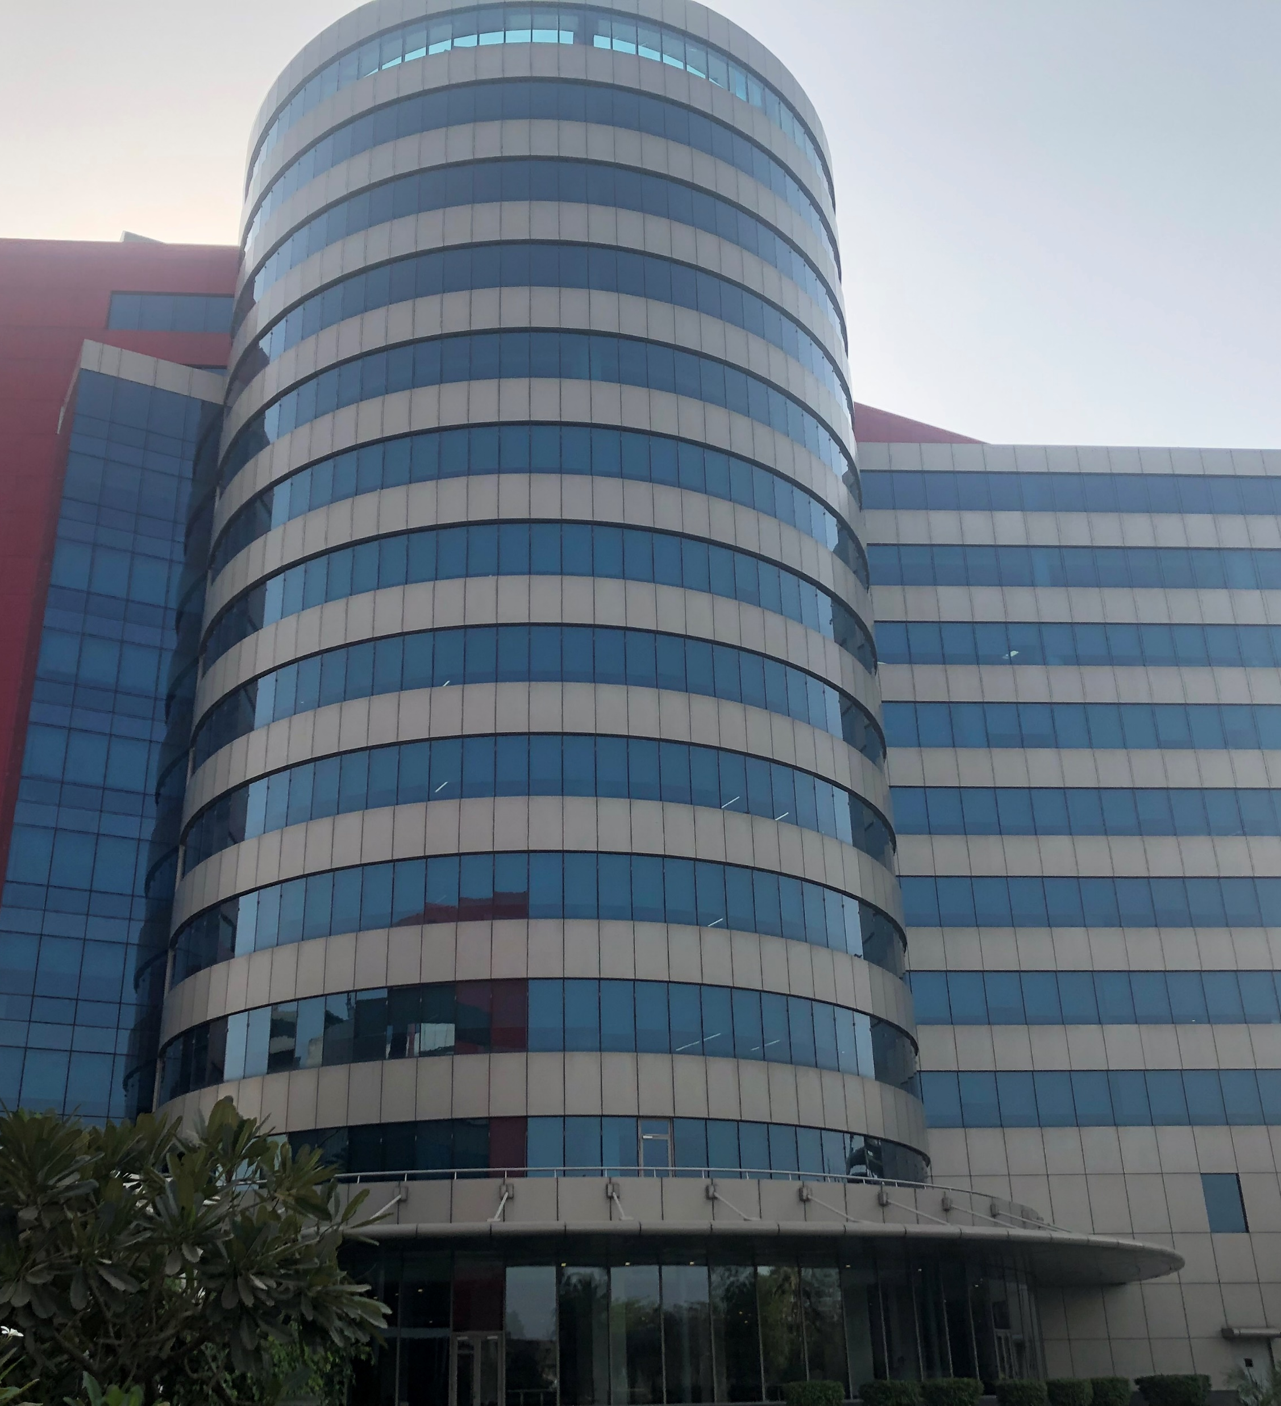

Thank You

